Slide 1
6 Sigma Assignment
1. Define
1) Define Issue
2) NG Rate & PPM
2. Measurement
1) Gage R&R outline
2) Type 1 Study
3) Type 2 Study
4) Process Capability Review
5) Conclusion
3. Analyze
1) Find the Root Cause
4. Improvement
1) Improvement activity
2) Check Process Capability
5. Control
2022.31.05
6 Sigma GB assignment
IVI LD – Vu Minh Vuong

Slide 2
Six Sigma Theme Registration
Team | IVI LD
T/L
Owner | Vu Minh Vuong
Theme | Bluetooth Distortion NTF of JLR P-IVI |  |  |  |  | Period | 2021.Nov.04~2022.Feb.04
Improve item |  | Target (Stretch Goal) |  |  |  | Idea (How to improve)
 |  | KPI | Current | World Best | Target
- Reduce NTF rate of Bluetooth distortion to 0 ppm |  | Total defect W40 (ppm) | 11628 (ppm) |  | 0 ppm (100%↓) | Separate ground for each equipment Increase delay time for measurement
Current Issue |  | Planning (Fast & Strong) |  |  |  | Organization
Measurement data is near USL 2. Defect rate is very high 3. Issue occurs in the long time
 |  |  |  |  |  | Location
 |  |  |  |  |  | LG Electronics Viet Nam Hai Phong
D
M
A
I
C
Name | Dept | Full Time | Part Time
V.M.Vuong | LD |  | O
N.N.An | PE | O
N.D.Quang | PM | O
P.P.Thao | MFG | O
04/11
11/11
18/11
26/11
20/12
- Define issue
- Define defect rate
- Gage R&R evaluate equipment
- Test sample
with using different spec
- Discuss with
HQ to improve
this issue
- Separate ground for each equipment
- Increase delay time for measurement
- Control defect rate of NTF issue through GMES system
Notes:
2

Slide 3
1. Define
D
I
C
M
A
1.1 Define Issue
Issue information
Issue: Bluetooth distortion test fail
Model: JLR P-IVI
Defect type: 25 / 2150 (11628 ppm)
Reason of choosing
This issue occurs with high defect rate
I choose this item because high NTF occurs frequently, UPH will be reduced
1.2 Defect rate
Defect symptom | Qty (EA) | %
Bluetooth distortion | 25 | 56.8%
Measure audio level | 10 | 4.5%
GPS fix check | 3 | 22.7%
Wi-Fi RSSI | 2 | 4.5%
Sleep current | 2 | 6.8%
Other | 2 | 4.5%
Total | 44 | 100%
Bluetooth distortion is worst defect of this part
→ I select this defect to make my 6sigma assignment
Notes:
Mục đích paretto chart?
Để xem nguyên nhân nào chiếm tỉ trọng cao nhất và cải tiến
To see what causes the highest density and make improvements
Nguyên lí áp dụng vào Pareto?
-Nguyên lí 20-80,
20% nguyên nhân ảnh hưởng tới 80% số lượng lỗi
The 20-80 Principle, 20% of causes affect 80% of the number of errors
Tại sao chọn topic này?
Theo biểu đồ pareto, đây là worst issue

Slide 4
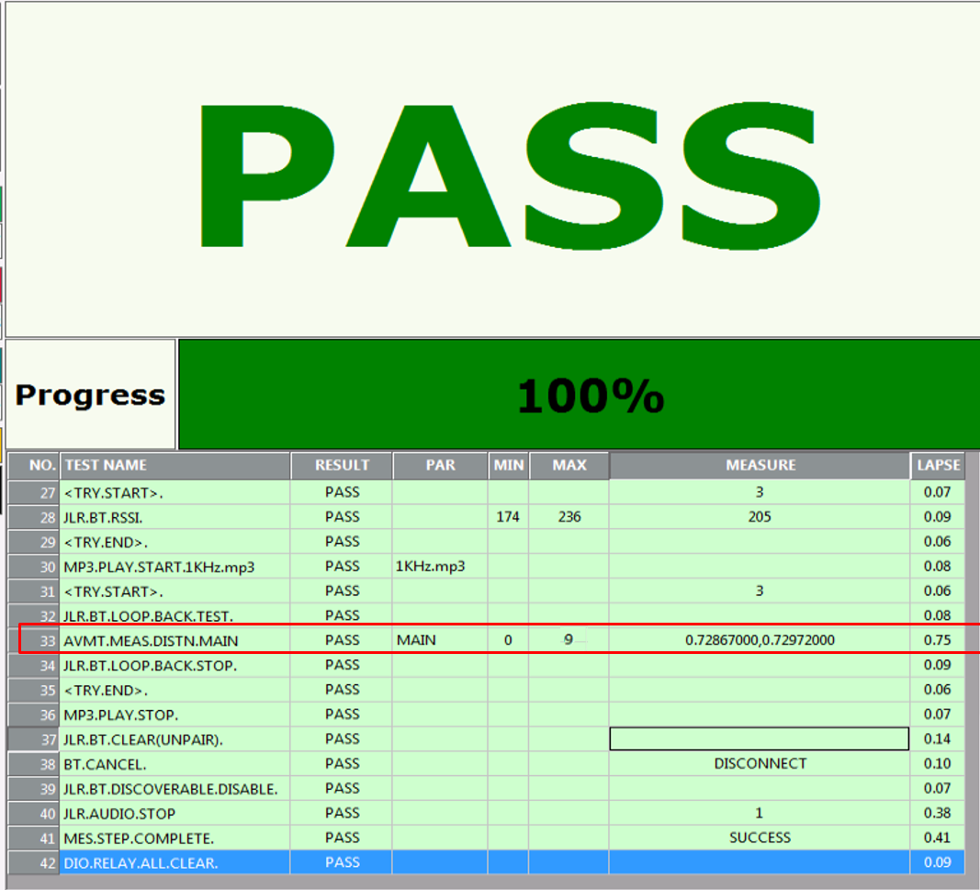
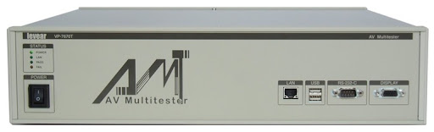
2. Measurement
D
I
C
M
A
2.1 Gage R&R outline
Name: Bluetooth distortion
Part: JLR P-IVI
Spec: 0 ~ 9 Vrms
Method: measure Bluetooth distortion when play mp3 file
Equipment: Audio Video Multi Tester (AVMT)
Resolution: 0.000001Vrms
Audio Video Multi Tester
Bluetooth station
Station 1
Station 2
Notes:
Difference between calibration and Gage R&R?
Calibration only check repeatability
Gage R&R can check both repeatability & reproducibility

Slide 5
2. Measurement
D
I
C
M
A
2.2 Type 1 Study (Station 1)
No | Bluetooth Distortion (Vrms)
1 | 0.64436
2 | 0.64901
3 | 0.67625
4 | 0.63142
5 | 0.66855
6 | 0.67168
7 | 0.65221
8 | 0.6352
9 | 0.63904
10 | 0.67939
11 | 0.65681
12 | 0.67688
13 | 0.63755
14 | 0.67726
15 | 0.63269
16 | 0.63062
17 | 0.63636
18 | 0.63316
19 | 0.66101
20 | 0.64196
21 | 0.65418
22 | 0.66586
23 | 0.67449
24 | 0.67951
25 | 0.62231
Capability
- Cg = 16.08 (Standard >1.33) → OK
Cgk = 16.08 (Standard >1.33) → OK
%Var(Repeatability) = 1.24% (Standard <10%) → OK
%Var(Repeatability and Bias) = 1.24% (Standard <10%) → OK
Resolution < 5% of Tolerance → OK
Conclusion: The AVMT1 can be used to measure Bluetooth distortion
Notes:
1. How to process Type I?
We need to measure 30 times for one sample which reference value is known
How to choose Sampling? Chọn mẫu như thế nào?
Just choose random sample and know the reference value- 1 mẫu ngẫu nhiên biết trước reference value
2. How to get the reference value? Làm sao để có reference value?
- There are two ways: Hai cách:
- First: Use equipment has high precision (accuracy) Sử dụng thiết bị đo chính xác cao.
- Second: Measure one sample 10 times with equipment has high precision then get mean (average) of these measured values. Đo lặp lại part 10 lần với 1 dụng cụ đo chính xác, sau đó lấy trung bình
3. Cg, Cgk là gì?
Cg and Cgk are Measuring capacity index of measuring equipment --- Chỉ số năng lực đo đạc của thiết bị đo
Tiêu chuẩn: Cg, Cgk >=1.33
4. Phân biệt giữa Cg vs Cgk?
Cg is used when target and data mean are the same,
Cgk is used in case target and data mean is not the same.
5. Công thức của Cg &Cgk?
Cg=0.2(USL-LSL)/6sigma
Cgk=[0.1(USL-LSL)-(X-Xm)]/3sigma
Cp and Cpk are called Process Capability. Pp and Ppk are called Process Performance
The index takes into consideration the fact that your data is maybe not centered.
Cg=(USL-LSL)/6sigma within
Cg=(USL-u)/3sigma within, (u-LSL)/3sigma within
How many method to select sample?
Simple random
Stratified
Systematic
Cluster
Combination
Tiêu chuẩn resolution <5% lấy đâu ra? –Based on the standard of GM, Bosch, VDA 5
The acceptance criteria are less than 5% in GM, Bosch, … and less than 10% in AIAG, so the resolution of the instrument is satisfactory.
Tolerance=T=USL-LSL
%RE=RE/T

Slide 6
2. Measurement
D
I
C
M
A
2.2 Type 1 Study (Station 2)
No | Bluetooth Distortion (Vrms)
1 | 0.64069
2 | 0.65348
3 | 0.6382
4 | 0.63339
5 | 0.66777
6 | 0.67774
7 | 0.65283
8 | 0.63107
9 | 0.63777
10 | 0.62812
11 | 0.66994
12 | 0.67159
13 | 0.6256
14 | 0.67509
15 | 0.6248
16 | 0.63297
17 | 0.65025
18 | 0.6755
19 | 0.66173
20 | 0.64726
21 | 0.65568
22 | 0.67177
23 | 0.67727
24 | 0.6783
25 | 0.63914
Capability
- Cg = 16.05 (Standard >1.33) → OK
Cgk = 16.04 (Standard >1.33) → OK
%Var(Repeatability) = 1.25% (Standard <10%) → OK
%Var(Repeatability and Bias) = 1.25% (Standard <10%) → OK
Resolution < 5% of Tolerance → OK
Conclusion: The AVMT2 can be used to measure Bluetooth distortion

Slide 7
2. Measurement
D
I
C
M
A
2.3 Type 3 Study (Station 1)
Taking 20 parts randomly from the production process as a sample, presented the parts in random order, measured them using automatic
measuring equipment, and conducted 4 repetitive measurements using the same procedure, and obtained the following data
Measurement data using Bluetooth station No 1
Part | Bluetooth distortion (Vrms) | Part | Bluetooth distortion (Vrms) | Part | Bluetooth distortion (Vrms) | Part | Bluetooth distortion (Vrms) | Part | Bluetooth distortion (Vrms) | Part | Bluetooth distortion (Vrms) | Part | Bluetooth distortion (Vrms) | Part | Bluetooth distortion (Vrms) | Part | Bluetooth distortion (Vrms) | Part | Bluetooth distortion (Vrms)
1 | 0.65673 | 3 | 0.64584 | 5 | 0.64889 | 7 | 0.66718 | 9 | 0.64985 | 11 | 0.65100 | 13 | 0.64845 | 15 | 0.64979 | 17 | 0.64803 | 19 | 0.64740
1 | 0.65617 | 3 | 0.64589 | 5 | 0.64917 | 7 | 0.66756 | 9 | 0.64911 | 11 | 0.65119 | 13 | 0.64803 | 15 | 0.64957 | 17 | 0.64909 | 19 | 0.64771
1 | 0.65648 | 3 | 0.64532 | 5 | 0.64926 | 7 | 0.66775 | 9 | 0.64972 | 11 | 0.65194 | 13 | 0.64824 | 15 | 0.64921 | 17 | 0.64968 | 19 | 0.64738
1 | 0.65671 | 3 | 0.64539 | 5 | 0.64978 | 7 | 0.66750 | 9 | 0.64976 | 11 | 0.65124 | 13 | 0.64842 | 15 | 0.64937 | 17 | 0.64960 | 19 | 0.64700
2 | 0.66772 | 4 | 0.64644 | 6 | 0.65534 | 8 | 0.65531 | 10 | 0.65852 | 12 | 0.65654 | 14 | 0.64845 | 16 | 0.64817 | 18 | 0.64833 | 20 | 0.64977
2 | 0.66735 | 4 | 0.64672 | 6 | 0.65436 | 8 | 0.65544 | 10 | 0.65840 | 12 | 0.65544 | 14 | 0.64803 | 16 | 0.64834 | 18 | 0.64809 | 20 | 0.64944
2 | 0.66618 | 4 | 0.64627 | 6 | 0.65475 | 8 | 0.65536 | 10 | 0.65855 | 12 | 0.65581 | 14 | 0.64824 | 16 | 0.64886 | 18 | 0.64861 | 20 | 0.64947
2 | 0.66754 | 4 | 0.64626 | 6 | 0.65472 | 8 | 0.65660 | 10 | 0.65872 | 12 | 0.65570 | 14 | 0.64842 | 16 | 0.64771 | 18 | 0.64792 | 20 | 0.64832

Slide 8
2. Measurement
D
I
C
M
A
2.3 Type 3 Study (Station 1)
Notes:
Component of variation: represents of the percentage of change by item considered: the proportion of Gage R&R is small enough compared to Part to Part.
R-Chart: Represent the range of measurement of individual measurer. It is desirable that the measurement consistency and repeatability of the measurer, all points are within the control limits
Data by sample: represent the measured value of each part without distinguishing the measuere.
Xbar-Chart:

Slide 9
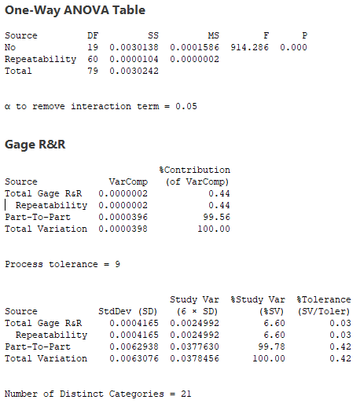
2. Measurement
D
I
C
M
A
2.3 Type 3 Study (Station 1)
P part = 0.000 < 0.05 → OK
The different between parts is significant at the significant level of 0.05 with a P value of 0.000 for the Part term.
Since we selected 20 different parts, each part should be
different.
% R&R = 0.44% < 10% → OK
Gage R&R contributes 0.44% of the total variation.
Part to part contributes 99.56% of the total change due to
the difference between the parts.
% Study Var = 6.60% < 10% → OK
% Toler : 0.03% < 10% → OK
NDC = 21 > 5 → OK
Conclusion: measurement system is OK
Notes:
1. P-value là gì? Minimum of alpha
2. Alpha is significant level, is the probability to conclude wrong in comparison with reality --- là xác suất để kết luận sai so với thực tế
3. P value of part < 0.05 là ok (sự khác biệt giữa các part là đáng kể)
4. P value of operator, p part x operator > 0.05 là ok (ko có sự khác biệt giữa những ng đo)
5. %study var: =%gage variance/Total variance -> đánh giá phương sai do hệ thống đo lường chiếm bao nhiêu % tổng phương sai
6. %tolerance = 6 x gage var/ Product spec -> thể hiện năng lực đánh giá sản phẩm OK/NG (Part OK đánh giá thành NG và ngược lại)
7. NDC: number of distinct categories: khả năng phân biệt của hệ thống đo
8. How to select sample for type III? Sample must be selected from all spec range, include NG sample
Randomly selects p parts in the production process ad measures the repeat r times and at least, 5 parts should be selected or p*r>50.
9. What is the condition when measuring sample? → Blind & Random
%contribution of Part – to – Part: big, means the different in measurement data come mainly from part (this is normal)
%contribution of Total gage R&R so small means the variance not come from measurement system.(good)
% repeatability: variance by gage
% reproducibility: variance by human
Điều kiện %study var, % tolerance <10% là ok
Từ 10 – 30% là conditional acceptance (với điều kiện cải tiến là bất khả thi, ko có kinh phí...)
NDC >= 5 là ok
Đô lệch chuẩn: standard deviation
Phương sai: variance
Repeatability: Check nhiệt độ, độ ẩm, mặt phẳng đặt thiết bị do, kết nối
Reproducibility: method training for operator is wrong or not.

Slide 10
2. Measurement
D
I
C
M
A
2.3 Type 3 Study (Station 2)
Taking 20 parts randomly from the production process as a sample, presented the parts in random order, measured them using automatic
measuring equipment, and conducted 4 repetitive measurements using the same procedure, and obtained the following data
Measurement data using Dark current station No 4
Part | Bluetooth distortion (Vrms) | Part | Bluetooth distortion (Vrms) | Part | Bluetooth distortion (Vrms) | Part | Bluetooth distortion (Vrms) | Part | Bluetooth distortion (Vrms) | Part | Bluetooth distortion (Vrms) | Part | Bluetooth distortion (Vrms) | Part | Bluetooth distortion (Vrms) | Part | Bluetooth distortion (Vrms) | Part | Bluetooth distortion (Vrms)
1 | 0.66000 | 3 | 0.64819 | 5 | 0.65166 | 7 | 0.64988 | 9 | 0.66688 | 11 | 0.65928 | 13 | 0.65339 | 15 | 0.65613 | 17 | 0.65561 | 19 | 0.65045
1 | 0.65953 | 3 | 0.64824 | 5 | 0.65150 | 7 | 0.65011 | 9 | 0.66827 | 11 | 0.65942 | 13 | 0.65323 | 15 | 0.65641 | 17 | 0.65551 | 19 | 0.65069
1 | 0.65992 | 3 | 0.64796 | 5 | 0.65211 | 7 | 0.65000 | 9 | 0.66678 | 11 | 0.65925 | 13 | 0.65314 | 15 | 0.65645 | 17 | 0.65605 | 19 | 0.65067
1 | 2.00212 | 3 | 0.64837 | 5 | 0.65182 | 7 | 0.64988 | 9 | 0.66665 | 11 | 0.65894 | 13 | 0.65369 | 15 | 0.65594 | 17 | 0.65604 | 19 | 0.65058
2 | 0.65598 | 4 | 0.65434 | 6 | 0.65012 | 8 | 2.00029 | 10 | 0.65243 | 12 | 0.65274 | 14 | 0.65535 | 16 | 0.65246 | 18 | 0.65120 | 20 | 0.65362
2 | 0.65553 | 4 | 0.65401 | 6 | 0.65005 | 8 | 0.94843 | 10 | 0.65236 | 12 | 0.65241 | 14 | 0.65569 | 16 | 0.65278 | 18 | 0.65119 | 20 | 0.65398
2 | 0.65611 | 4 | 0.65405 | 6 | 0.65037 | 8 | 0.64816 | 10 | 0.65214 | 12 | 0.65253 | 14 | 0.65527 | 16 | 0.65234 | 18 | 0.65113 | 20 | 0.65362
2 | 0.65590 | 4 | 0.65405 | 6 | 0.65012 | 8 | 0.64810 | 10 | 0.65233 | 12 | 0.65243 | 14 | 0.65500 | 16 | 2.00059 | 18 | 0.65138 | 20 | 0.65390

Slide 11
2. Measurement
D
I
C
M
A
2.3 Type 3 Study (Station 2)

Slide 12
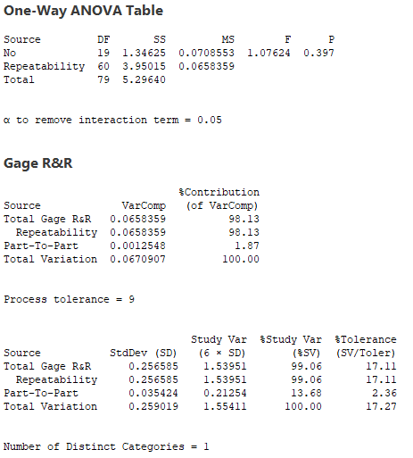
2. Measurement
D
I
C
M
A
2.3 Type 3 Study (Station 2)
P part = 0.397 > 0.05 → NG
→ The different between parts is not significant
% R&R = 98.13% > 10% → NG
% Study Var = 99.06% > 10% → NG
% Toler : 17.11% > 10% → NG
NDC = 1 < 5 → NG
Conclusion: measurement system is NG, need to check what
factors affect to measurement data

Slide 13
2. Measurement
D
I
C
M
A
2.4 Xbar-R Chart Review (Station 1)
Date | Sample 1 | Sample 2 | Sample 3 | Sample 4 | Sample 5
6-Sep | 0.65531 | 0.65182 | 0.64868 | 0.64963 | 0.65270
9-Sep | 0.65448 | 0.65279 | 0.64951 | 0.64880 | 0.65325
10-Sep | 0.65573 | 0.65269 | 0.64941 | 0.64965 | 0.65362
11-Sep | 0.65586 | 0.65256 | 0.64944 | 0.64939 | 0.65357
12-Sep | 0.65698 | 0.65136 | 0.64868 | 0.65032 | 0.65344
13-Sep | 0.65485 | 0.65272 | 0.64946 | 0.64933 | 0.65318
15-Sep | 0.65719 | 0.65184 | 0.64615 | 0.65048 | 0.65178
16-Sep | 0.65486 | 0.65162 | 0.64624 | 0.64983 | 0.65180
17-Sep | 0.65506 | 0.65237 | 0.64638 | 0.65052 | 0.65333
18-Sep | 0.65464 | 0.65104 | 0.64863 | 0.64986 | 0.65339
19-Sep | 0.65604 | 0.65152 | 0.64929 | 0.64977 | 0.65269
20-Sep | 0.65601 | 0.65236 | 0.64888 | 0.64956 | 0.65179
22-Sep | 0.65601 | 0.65110 | 0.64901 | 0.64898 | 0.65207
23-Sep | 0.65533 | 0.65135 | 0.64625 | 0.64864 | 0.65220
24-Sep | 0.65494 | 0.65267 | 0.64659 | 0.65018 | 0.65249
25-Sep | 0.65485 | 0.65194 | 0.64714 | 0.65029 | 0.65189
26-Sep | 0.65603 | 0.65208 | 0.64886 | 0.65033 | 0.65231
27-Sep | 0.65452 | 0.65176 | 0.64900 | 0.64964 | 0.65302
29-Sep | 0.65503 | 0.65111 | 0.64735 | 0.65004 | 0.65341
30-Sep | 0.65495 | 0.65095 | 0.64882 | 0.64965 | 0.65207
Conclusion:
No abnormality can be found in Xbar control chart and R control chart
Therefore stability is Pass
Notes:
1. How to select sample for Process Capability? $→$Select by Rational subgroup
– Lấy theo lot, n con liền nhau của mỗi lot (n<=5), tại các khoảng thời gian cố định. Vd: cách 2 tiếng một lần trong nhiều ngày liên tiếp
Mục đích: để đảm bảo điều kiện
của những sample đc lấy là giống hệt nhau, chỉ tồn tại chance cause trong mỗi nhóm)
Tại sao n <= 5? Vì từ con thứ 6 trở đi không đảm bảo điều kiện giống
như con đầu tiên nữa.
How do I choose a template for Process Capability? - Take in lots, at least5 samples(n <= 5), at fixed intervals of time. Example: every 2 hours for several consecutive days to security conditions of the sample is taken the same, there is only chance cause in each group) Why is n <= 5? Because the 6th child onwards is not the same as a security condition as the first first.
3. Why use control chart? Control chart used to detect abnormal of the process at earlier stage

Slide 14
2. Measurement
D
I
C
M
A
2.5 Process Capability review (Station 1)
P-Value = 0.116 > 0.05 → Pass
Cpk = 74.84 (Standard ≥ 1.67) → Pass
Notes:
1. Why run Normality test? To check the data sample follow normal distribution or not. In hypothesis test, H0: data follow nor.dist, H1: don’t follow nor.dist.
We need H0, so p-value must >0.05.
Cp, Cpk là gì? – are used to determine the process capability in Mass production stage. Chỉ số đánh giá năng lực quy trình.
Cp ≥ 1.67, 1.33, 1.0 (tùy hạng mục CC hay FC) là ok
Cpk ≥ 1.67, 1.33, 1.0 (tùy hạng mục CC hay FC) là ok
Cp cpk nhỏ hơn điều kiện trên => cải tiến
2. Phân biệt giữa Cp vs Cpk? Cp use when target is centered, Cpk used in case target is not centered.
3. Different between Cp & Pp (Cpk & Ppk)?
- Pp, Ppk are used in development stage, when process is unstable, Cp, Cpk are used in Mass Production stage

Slide 15
2. Measurement
D
I
C
M
A
2.4 Xbar-R Chart Review (Station 2)
Date | Sample 1 | Sample 2 | Sample 3 | Sample 4 | Sample 5
6-Sep | 0.65300 | 0.65884 | 0.65019 | 0.66291 | 0.64866
9-Sep | 0.65769 | 0.65919 | 0.75930 | 0.66055 | 0.67666
10-Sep | 0.76367 | 0.74315 | 0.75048 | 0.66652 | 0.66232
11-Sep | 0.66389 | 0.75780 | 1.05732 | 0.74567 | 0.65479
12-Sep | 0.65601 | 0.65009 | 0.74943 | 1.66257 | 0.66367
13-Sep | 0.66224 | 0.65730 | 0.74466 | 0.65552 | 0.68640
15-Sep | 0.66714 | 0.65780 | 0.75190 | 0.74735 | 0.65257
16-Sep | 0.76980 | 0.75991 | 0.59361 | 0.65668 | 0.65038
17-Sep | 1.66382 | 0.63920 | 0.72509 | 0.66843 | 0.65823
18-Sep | 0.66701 | 0.54586 | 0.65897 | 0.73405 | 0.63863
19-Sep | 0.67235 | 0.74853 | 0.58828 | 0.63598 | 0.66363
20-Sep | 0.62865 | 0.65260 | 0.57525 | 0.56581 | 0.65805
22-Sep | 2.65101 | 0.55446 | 0.58623 | 0.70074 | 0.65491
23-Sep | 0.59733 | 0.63952 | 0.71601 | 1.70984 | 0.65068
24-Sep | 0.61969 | 0.78940 | 0.70513 | 0.66257 | 0.65535
25-Sep | 0.70702 | 0.58640 | 2.78131 | 0.56647 | 0.59244
26-Sep | 0.63749 | 1.57235 | 0.58146 | 0.62361 | 0.63575
27-Sep | 0.79000 | 0.65552 | 0.70702 | 0.66925 | 0.73642
29-Sep | 0.63590 | 0.76389 | 0.65943 | 0.65102 | 0.75991
30-Sep | 0.59519 | 0.57076 | 0.66707 | 0.70062 | 0.51249
Conclusion:
Abnormality can be found in Xbar control chart and R control chart
Therefore stability is Fail
Notes:
1. How to select sample for Process Capability? $→$Select by Rational subgroup
– Lấy theo lot, n con liền nhau của mỗi lot (n<=5), tại các khoảng thời gian cố định. Vd: cách 2 tiếng một lần trong nhiều ngày liên tiếp
Mục đích: để đảm bảo điều kiện
của những sample đc lấy là giống hệt nhau, chỉ tồn tại chance cause trong mỗi nhóm)
Tại sao n <= 5? Vì từ con thứ 6 trở đi không đảm bảo điều kiện giống
như con đầu tiên nữa.
How do I choose a template for Process Capability? - Take in lots, at least5 samples(n <= 5), at fixed intervals of time. Example: every 2 hours for several consecutive days to security conditions of the sample is taken the same, there is only chance cause in each group) Why is n <= 5? Because the 6th child onwards is not the same as a security condition as the first first.
3. Why use control chart? Control chart used to detect abnormal of the process at earlier stage

Slide 16
2. Measurement
D
I
C
M
A
2.5 Process Capability review (Station 2)
P-Value = < 0.05 → Fail
Cpk = 0.69 (Standard ≥ 1.67) → Fail
Notes:
1. Why run Normality test? To check the data sample follow normal distribution or not. In hypothesis test, H0: data follow nor.dist, H1: don’t follow nor.dist.
We need H0, so p-value must >0.05.
Cp, Cpk là gì? – are used to determine the process capability in Mass production stage. Chỉ số đánh giá năng lực quy trình.
Cp ≥ 1.67, 1.33, 1.0 (tùy hạng mục CC hay FC) là ok
Cpk ≥ 1.67, 1.33, 1.0 (tùy hạng mục CC hay FC) là ok
Cp cpk nhỏ hơn điều kiện trên => cải tiến
2. Phân biệt giữa Cp vs Cpk? Cp use when target is centered, Cpk used in case target is not centered.
3. Different between Cp & Pp (Cpk & Ppk)?
- Pp, Ppk are used in development stage, when process is unstable, Cp, Cpk are used in Mass Production stage

Slide 17
2. Measurement
D
I
C
M
A
2.6 Conclusion
Conclusion:
Base on Type 1 and 3, Station 1 is stable and capability is good. But station 2 is unstable and lack of capability
Base on process capability measure by Station 1 is ok, process capability is ok.
=> Improvement Measurement System station 2
 | Cgk |  |  | %Val | %Tolerence | NDC
 | Actual | Standard | Result
Station 1 | 16.08 | 1.33 | Good | 6.60% | 0.03% | 21
Station 2 | 16.04 | 1.33 | Good | 99.06% | 17.1% | 1

Slide 18
3. Analyze
D
I
C
M
A
3.1 Find the Root Cause
Logic tree analysis
Power supply is unstable

Power supply
Separate DC power from test bench
Done
(Applied: 18.Nov)

Machine
Pallet
Relay was not working
Repair pallet
Done
(Applied: 20.Nov)

Measure incorrectly due to noise
Separate ground for each equipment
Done
(Applied: 02.Nov)
Audio Video Multi Tester
Accuracy is bad
Audio Video Multi Tester is calibrated frequently
→ OK

Method
Timing
Measure distortion after play MP3 file
Increase delay after play MP3 file
Done
(Applied: 06.Nov)
Bluetooth distortion at Station 2 (NTF)
Material
Set
Set is no problem
Plug in set to pallet not fully
If not plug in set fully, previous inspection will be fail
Not relate to set plugging in
Man
Working skill
Automatic process
Man is not related

: Potential factor

Slide 19
4. Improvement
D
I
C
M
A
4.1 Separate DC power from test bench
- Test bench includes SMPS (Switching Mode Power Supply). The power quality of SMPS is not good (high ripple), it can make noise and affect to measurement data.
→ Separate power supply from test bench to improve power quality.
As is
To be
DC power
DC power
Test bench
Test bench
Set
Set

Slide 20
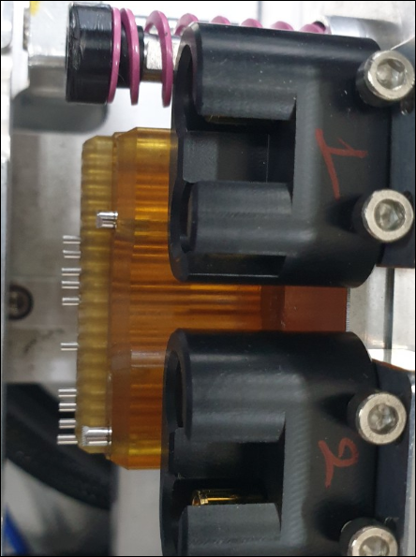
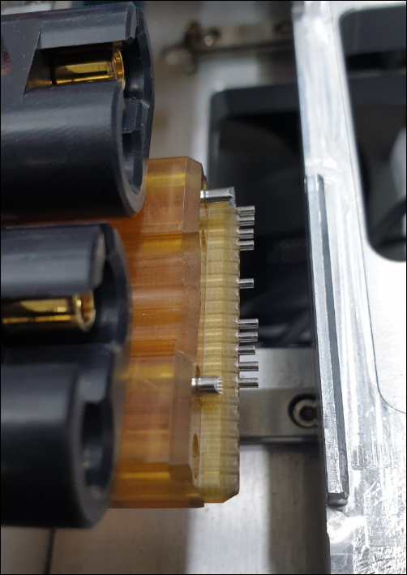


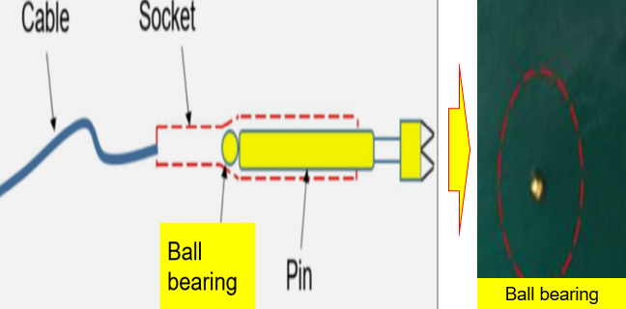
4. Improvement
D
I
C
M
A
4.2 Repair pallet
- Bluetooth distortion is measured through pogo pin from Set to AVMT. So, if the ground connection is not good, it can make noise and affect to measurement data
→ Add more ball bearing for ground pogo pin to increase electrical conductivity
Before
After
Case Ground Pogo pin no use ball bearing
Adding ball bearing for Ground Pogo Pin

Slide 21
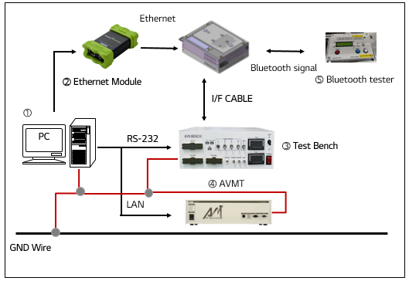
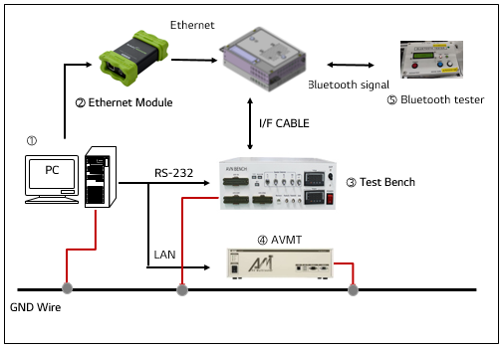
4. Improvement
D
I
C
M
A
4.3 Separate ground for each equipment
Before, ground of each equipment is connect with each other, so when measuring Bluetooth distortion data, power noise of other equipment can affect to AVMT, it makes data incorrect
→ Separate ground of all equipment.
Use common GND Wire
Separate GND Wire

Slide 22
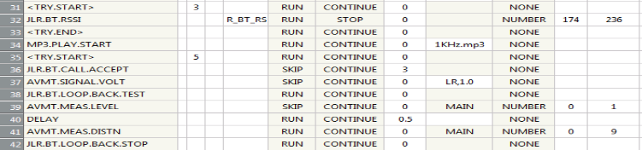
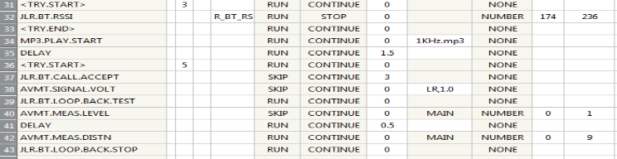
4. Improvement
D
I
C
M
A
4.4 Increase delay after play MP3 file
Bluetooth distortion is measured after Set play MP3 file completely. The measured data is not a stable if Set not yet play file.
→ Add 1.5s delay for playing MP3 file, Bluetooth signal will be stable, so AVMT will measure data correctly.
Before
After

Slide 23
4. Improvement
D
I
C
M
A
4.2 Check Gage Study Type 3 at Station 4
Taking 20 parts randomly from the production process as a sample, presented the parts in random order, measured them using automatic
measuring equipment, and conducted 4 repetitive measurements using the same procedure, and obtained the following data
Measurement data using Dark current station No 4
Part | Sleep current (mA) | Part | Sleep current (mA) | Part | Sleep current (mA) | Part | Sleep current (mA) | Part | Sleep current (mA) | Part | Sleep current (mA) | Part | Sleep current (mA) | Part | Sleep current (mA) | Part | Sleep current (mA) | Part | Sleep current (mA)
1 | 0.15953 | 3 | 0.14819 | 5 | 0.15166 | 7 | 0.14988 | 9 | 0.16688 | 11 | 0.15928 | 13 | 0.15339 | 15 | 0.15613 | 17 | 0.15561 | 19 | 0.15045
1 | 0.16000 | 3 | 0.14824 | 5 | 0.15150 | 7 | 0.15011 | 9 | 0.16727 | 11 | 0.15942 | 13 | 0.15323 | 15 | 0.15641 | 17 | 0.15551 | 19 | 0.15069
1 | 0.15992 | 3 | 0.14796 | 5 | 0.15211 | 7 | 0.15000 | 9 | 0.16678 | 11 | 0.15925 | 13 | 0.15314 | 15 | 0.15645 | 17 | 0.15605 | 19 | 0.15067
1 | 0.15887 | 3 | 0.14837 | 5 | 0.15182 | 7 | 0.14988 | 9 | 0.16665 | 11 | 0.15894 | 13 | 0.15369 | 15 | 0.15594 | 17 | 0.15604 | 19 | 0.15058
2 | 0.15598 | 4 | 0.15434 | 6 | 0.15012 | 8 | 0.14829 | 10 | 0.15243 | 12 | 0.15274 | 14 | 0.15535 | 16 | 0.15246 | 18 | 0.15120 | 20 | 0.15362
2 | 0.15553 | 4 | 0.15401 | 6 | 0.15005 | 8 | 0.14843 | 10 | 0.15236 | 12 | 0.15241 | 14 | 0.15569 | 16 | 0.15278 | 18 | 0.15119 | 20 | 0.15398
2 | 0.15611 | 4 | 0.15405 | 6 | 0.15037 | 8 | 0.14816 | 10 | 0.15214 | 12 | 0.15253 | 14 | 0.15527 | 16 | 0.15234 | 18 | 0.15113 | 20 | 0.15362
2 | 0.15590 | 4 | 0.15405 | 6 | 0.15012 | 8 | 0.14810 | 10 | 0.15233 | 12 | 0.15243 | 14 | 0.15500 | 16 | 0.15366 | 18 | 0.15138 | 20 | 0.15390

Slide 24
4. Improvement
D
I
C
M
A
4.2 Check Gage Study Type 3 at Station 4

Slide 25
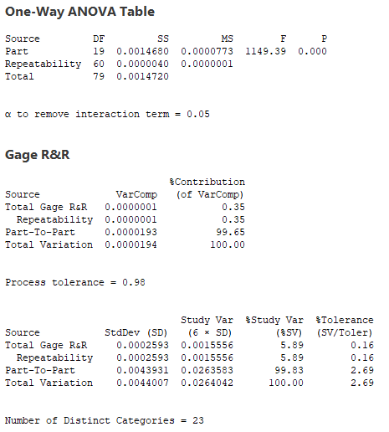
4. Improvement
D
I
C
M
A
4.2 Check Gage Study Type 3 at Station 4
P part = 0.000 < 0.05 → OK
→ The different between parts is significant
% R&R = 0.35% < 10% → OK
% Study Var = 5.89% < 10% → OK
% Toler : 0.16% < 10% → OK
NDC = 23 > 5 → OK
Conclusion: measurement system is OK

Slide 26
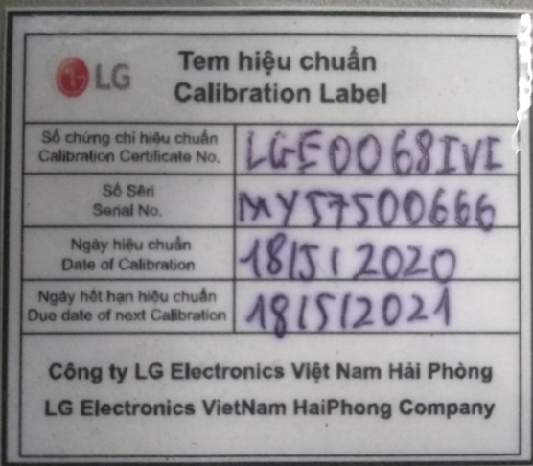
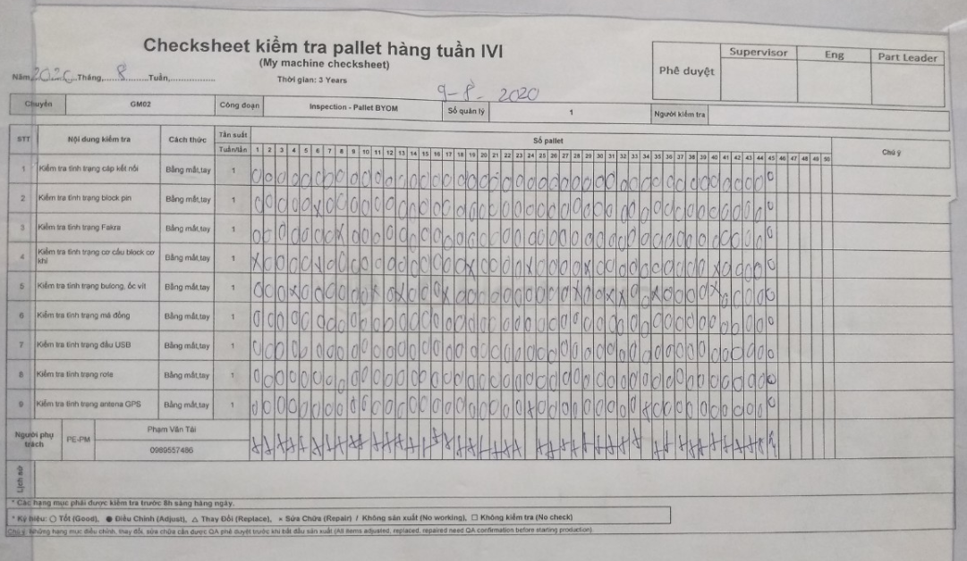
5. Control
D
I
C
M
A
5.1 DMM equipment
Control by Nguyễn Việt Anh (PM member), calibrated time is yearly
Main PIC | Nguyễn Anh Việt (PM member)
Time calibration | Yearly
Equipment | DMM
Quantity | 4
DMM calibration label
5.2 Pallet
Control by Nguyễn Việt Anh (PM member), repair pallet weekly by pallet check sheet
Main PIC | Nguyễn Anh Việt (PM member)
Time calibration | Weekly
Equipment | Pallet
Quantity | 40
Pallet daily check sheet

Slide 27
5. Control
D
I
C
M
A
Main PIC | Nguyễn Anh Việt (PM member)
Time calibration | Yearly
Equipment | DMM
Quantity | 4
Main PIC | Nguyễn Anh Việt (PM member)
Time calibration | Weekly
Equipment | Pallet
Quantity | 40
DMM calibration label
Pallet daily check sheet

